Slide 1
Lesson 10: Web Site Development for Business

Slide 2
Lesson 10 Objectives
Develop a business Web site
Discuss the three e-commerce models
Identify the relationship between Internet marketing and search engine optimization (SEO)
Identify payment models used in e-commerce
Identify issues related to working in a global environment
Explore the relationship between databases and Web pages
Discuss ways to optimize the impact of the Web page
Identify Web page front-end design issues
Identify file formats for use in Web pages
Identify Web page back-end resource issues
Calculate bandwidth and download time
Name Web page files

Slide 3
Developing a Business Web Site
Web sites can serve as a business's primary means of advertising and marketing
Brand – a concept or collection of symbols associated with a product, service or person
Should be simple
Should be different
Should be safe
Should make a promise
Should reflect the company's attributes
Should reflect the company's personality
Should appeal to the intended audience

Slide 4
Developing a Business Web Site (cont’d)
Customers do not read Web pages; they scan them
Effectively designed pages:
Feature crisp, concise text
Include one idea per paragraph
Include search engine keywords in the main portions of text
Convey the central message using the inverted-pyramid writing style

Slide 5
E-Commerce Considerations
There are three major e-commerce models that are widely implemented:
Business to consumer (B2C)
Business to business (B2B)
Consumer to consumer (C2C)

Slide 6
Internet Marketing and Search Engine Optimization (SEO)
Marketing terms
Internet marketing consists of:
Search engine optimization (SEO)
Pay per click (PPC)
Web analytics

Slide 7
Search Engine Optimization (SEO)
SEO improves the volume and quality of traffic to a Web site by structuring content to improve search engine ranking
An SEO expert must:
Learn about and consider the factors that search engines take into account as they rank sites
Try to create and edit Web pages accordingly

Slide 8
Pay Per Click (PPC)
PPC – list your site high in search engine rankings by advertising on keywords that describe your product or service
You simply pay to have your page listed as highly as possible
Most Internet marketing campaigns combine SEO and PPC strategies

Slide 9
Web Analytics
Web analytic types:
On-site analytics
Study visitor behavior once that visitor has accessed your site
Off-site analytics
Identify the size of your market
Identify competitors
Determine your market penetration
Conduct surveys
Consult market research sources

Slide 10
E-Commerce Payment Technologies
Payment technologies include:
Electronic Funds Transfer (EFT)
Payment gateways
3-D Secure

Slide 11
Secure Sockets Layer (SSL) / Transport Layer Security (TLS)
Not transaction methods
Used to secure transactions through encryption
Services provided:
Authentication
Data confidentiality
Data integrity

Slide 12
SSL/TLS and Public Key Infrastructure (PKI)
You need a certificate to enable host authentication before you can begin an SSL session
Public Key Infrastructure (PKI) – a collection of individuals, networks and computers that comprise the ability to authoritatively confirm the identity of a person, host or organization
PKI involves two elements:
Digital certificate
Certificate authority (CA)

Slide 13
Working in a Global Environment
By placing your business on the Web, you expand your audience to include anyone in the world with a browser and Internet access
Consider the level to which you will accommodate potential customers from countries outside yours
Issues to consider include:
Currency differences
International shipping
Language concerns
Relationship management

Slide 14
Databases and Web Pages
Databases can store information about company inventory
Databases can store customer information

Slide 15
Web Pages and CGI
CGI can be used to help Web pages pass information to and from databases
Examples of CGI technology include:
Perl
PHP Hypertext Preprocessor (PHP)
Active Server Pages (ASP) and .NET
JavaServer Pages (JSP)
ColdFusion
Python
Django
Ajax
Ruby

Slide 16
Optimizing the Impact of the Web Page
SEO techniques are designed to get Web pages to conform to the expectations of search engine applications
Search engine companies consider:
How many hyperlinks from other sites point to a page
How informative a page is
How well a page's code is structured
How often the content on the page is updated
As you optimize pages for SEO, you should:
Use properly validated HTML code
Apply Cascading Style Sheets (CSS)
Structure pages correctly

Slide 17
Front-End Issues
A Web page is an interface that should:
Be accessible by all users
Incorporate appealing images and graphical elements
Include constantly updated hyperlinks
Use tables wisely
Present carefully designed Web forms
Connect pages to databases securely
Use the most current technologies appropriate for the page
Use images sparingly
Be easily navigable and without dead ends
Include alternative navigation links

Slide 18
Site Maps
Allow visitors to view a summary of your Web site's structure
A useful site map is the product of proper site planning
Useful site maps include:
Topical hierarchy
Aptly named site sections
Search capability

Slide 19
Creative Design and Branding Standards
A Web page is often part of a larger marketing and sales strategy
Creating and ensuring brand recognition (name recognition)
Presenting a strong message
A Web page allows you to develop:
A market
Mind share
A brand

Slide 20
Creative Design and Branding Standards (cont'd)
Design and branding standards meetings focus on the following:
Target markets
Market messages
Media choices
Color combinations
Sales strategies
Technologies to use

Slide 21
Creative Design and Branding Standards (cont'd)
Audience development techniques include:
Flash, Java
Unique Web site features
Company logos
Strategies developed by sales and marketing
Push and pull technologies
Visitor tracking

Slide 22
Portals
A Web site that acts as a centralized access point for additional Web sites
Portal types:
Vertical
Horizontal
Portal benefits:
Directs users to the best sites
Attracts users to products
Improves brand name

Slide 23
Wiki Site
A Web site that allows all visitors to collaborate in its construction
Wiki software is installed on a Web server
You can lock down certain pages and leave others open to editing
Most wiki pages are written in a simplified markup language called LaTeX (www.latex-project.org) that accommodates the fast-paced nature of a wiki site
The word wiki is coined from the Hawaiian phrase "wiki wiki," which means "very quick"

Slide 24
Documenting Changes
Keep a written record of all changes to your Web site
Documenting change allows you to:
Remember which changes have been made to the HTML code and/or pages on the site
Ensure that you publish all security updates to the Web server
Provide evidence of good-faith efforts to ensure accessibility
Verify that you have fulfilled requests from departments in your organization

Slide 25
File Formats and Active Content
Your pages will include various content formats, including PDF documents, images and media files
Common file formats and MIME types
HTML: text/html
JPEG: image/jpeg
Cascading Style Sheets (CSS): text/css
MPEG: audio/mpeg
MP3: audio/mp3
Evaluating proprietary formats
Difficulty/inconvenience
Cost
Audience limitation

Slide 26
Back-End Issues
Database connectivity
Databases provide the ability to:
Present stored information to customers, and allow them to search and retrieve
Receive information from customers and save it for later retrieval
Types of databases
Flat file
Non-relational
Relational
Object-oriented
Web servers use relational databases to store data

Slide 27
Back-End Issues (cont’d)
Relational databases
Store information in tables
Can consist of a single file or can be distributed among several database servers
Structured Query Language (SQL)
Used to create and maintain professional, high-performance corporate databases
Database connection methods
Open Database Connectivity (ODBC)
Java Database Connectivity (JDBC)
Indexing and cataloging

Slide 28
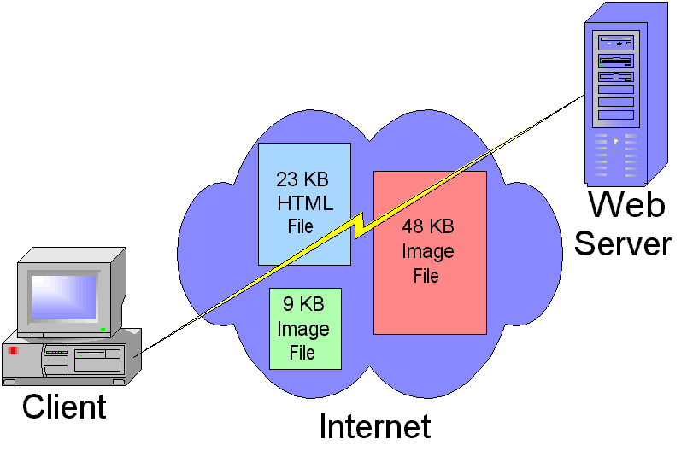
Bandwidth and Download Time
Download time
Factor in all files
Consider typical connection speeds
Calculate download time for a Web page
Check the size of the HTML file and all associated images, files or programs
Determine the speed of your network connection
Convert the connection speed and file size to common units of measure (e.g., bytes or bits)
Divide file size by connection speed

Slide 29
Naming Web Page Files
Web servers search for default page names
Default page names include:
index.html
index.htm
default.htm
default.asp
Default page names can change from server to server
Apache Server – usually index.html
IIS – usually default.htm, default.html or index.html

Slide 30
HTTP 404 – File Not Found Error
Indicates that a user has requested a file that does not exist on the specified Web server
Generated by the server
Can be customized

Slide 31
Lesson 10 Summary
Develop a business Web site
Discuss the three e-commerce models
Identify the relationship between Internet marketing and search engine optimization (SEO)
Identify payment models used in e-commerce
Identify issues related to working in a global environment
Explore the relationship between databases and Web pages
Discuss ways to optimize the impact of the Web page
Identify Web page front-end design issues
Identify file formats for use in Web pages
Identify Web page back-end resource issues
Calculate bandwidth and download time
Name Web page files

