Slide 1
Lesson 7: Video, Audio and Image Techniques

Slide 2
Lesson 7 Objectives
Use the <video> element to embed video in Web pages
Use the <audio> element to embed audio in Web pages
Define graphic types
Create client-side image maps
Define image transparency
Define image interlacing
Use Web-based technologies to create animation
Explore mobile device issues with animation and plug-ins
Create and manage images

Slide 3
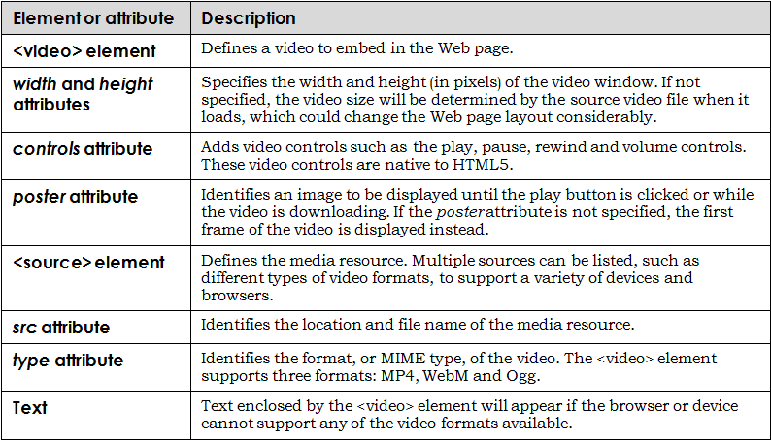
The <video> Element
Video elements and attributes:

Slide 4
The <video> Element (cont’d)
HTML5-compliant browser support for HTML5 video formats and codecs:

Slide 5
The <audio> Element
The <audio> element allows developers a standard method to embed audio into Web pages
The controls attribute identifies the default audio controls: play, pause, volume, etc.
Multiple sources can be identified with the <source> element to ensure various audio formats are supported

Slide 6
The <audio> Element (cont’d)
HTML5-compliant browser support for HTML5 audio formats:
Additional <audio> and <video> attributes:

Slide 7
Graphic Types
Vector
Graphics that use mathematical coordinates with lines, curves and shapes to create desired images and specify colors
Bitmap
Graphics that use small dots (usually thousands) to create an image and specify color
Also known as raster graphics

Slide 8
Image Maps
An image that contains hyperlinked, clickable regions, sometimes called "hot spots"
Each hot spot is defined by a set of coordinates (indicating its position on the image) and a URL reference
Two types of image maps:
Client-side (the most common)
Server-side (rarely used)

Slide 9
Defining a Client-Side Image Map
Define a map, assign it a name, and provide hot-spot coordinates
Refer to the image map by map name:
<map name="mapname">
<area shape="shape" coords="coordinates" href="url" alt="description"/>
<area shape="shape" coords="coordinates" href="url" alt="description"/>
<area shape="shape" coords="coordinates" href="url" alt="description"/>
</map>
Associate the image file with the map:
<img src="imagemap.gif" usemap="#mapname"/>

Slide 10
Defining a Rectangle Hot Spot
Any two points can define a rectangle
Each point is represented by a horizontal (x) coordinate and a vertical (y) coordinate
Rectangles are defined by four coordinates representing the upper-left and bottom-right corners of the rectangle <area shape="rect" coords="x1,y1,x2,y2" href="url" alt="description"/>

Slide 11
Defining a Circle Hot Spot
Circles are defined by two coordinates and a radius <area shape="circle" coords="x1,y1,radius" href="url " alt="description"/>
The pair of coordinates specifies the circle's center
A third number specifies the desired radius, or half-width, of the circle

Slide 12
Defining a Polygon Hot Spot
Defines an irregular area (neither a circle nor a rectangle)
Specify coordinates for each point that defines the polygon, from three to 100 pairs of coordinates <area shape="poly" coords="x1,y1,x2,y2,...xn,yn" href="url " alt="description"/>

Slide 13
Image Transparency
Provides the visual effect of blending in to the background of the Web page
Most developers use image transparency to remove the blank image background so it appears to float on the page
Web-ready formats that support transparency:
GIF 89a
PNG

Slide 14
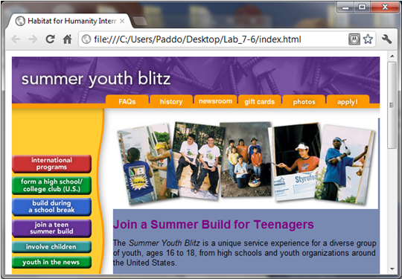
Image with No Transparency

Slide 15
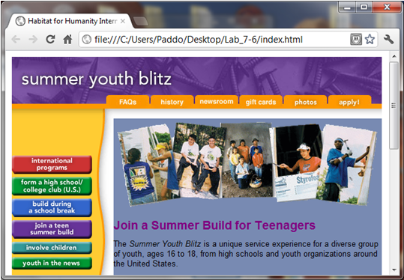
Transparent PNG Image

Slide 16
Image Interlacing
Allows an image to progressively display in a browser while downloading
The image appears in stages during download (from top to bottom)
The top of a non-interlaced image will appear after the browser has read 50 percent of the image

Slide 17
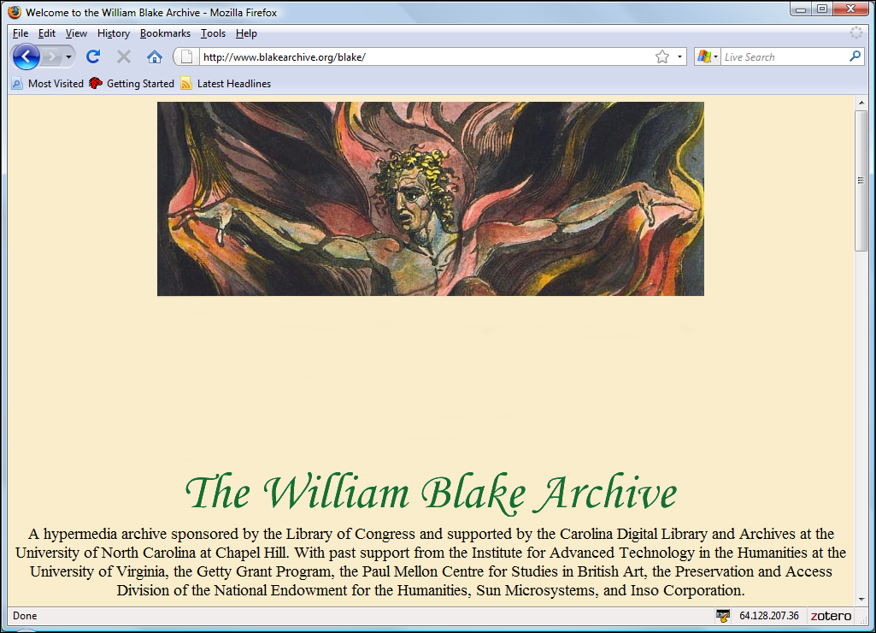
Image Interlacing (cont'd)

Slide 18
Animation
Several images in a sequence, rendered in rapid succession to simulate motion
Made possible in several ways:
Animated GIFs and PNGs
The animated image is actually a group of separate, sequenced images
Flash
Scripts, called macros, that manipulate vector images
Popular, but proprietary technology (Adobe)
Requires a browser plug-in to view
Silverlight – Microsoft's answer to Flash
Java applets – requires a Java interpreter to view
Scalable Vector Graphics (SVG) – an open standard

Slide 19
Mobile Device Issues with Animation and Plug-Ins
As you create animated images, remember the following issues:
Animation techniques are often proprietary
Plug-ins drain system resources
Animation may seem useful and interesting, but it is frequently overused
Animated images can limit accessibility

Slide 20
Creating and Managing Images
There are several options you can use to obtain and manage images for use on your Web pages:
Create original images using image-creation software
Scan hard-copy images
Use stock photographs
Obtain photos from photo-sharing Web sites
Use photo management software to organize, edit and share your images
Consider search engine optimization (SEO) issues when creating and using images

Slide 21
Lesson 7 Summary
Use the <video> element to embed video in Web pages
Use the <audio> element to embed audio in Web pages
Define graphic types
Create client-side image maps
Define image transparency
Define image interlacing
Use Web-based technologies to create animation
Explore mobile device issues with animation and plug-ins
Create and manage images

