Slide 1
Lesson 6: Web Forms

Slide 2
Lesson 6 Objectives
Discuss the importance of CGI to Web forms
Discuss HTML5 and Web forms
Identify basic Web form tags
Construct a Web form using Web form fields

Slide 3
Introduction to Web Forms
Forms are used to obtain information from users
Input can include the user’s name, address or credit card number, for example
The information that a user submits in the form is sent to a server, where it is stored and/or processed
Forms are essential for e-commerce, as well as for gathering information

Slide 4
Web Forms and CGI
To be truly functional, a form requires the use of a Common Gateway Interface (CGI) program to process and organize the user input
A CGI script residing on a server performs two important functions:
Receives data from a Web browser
Processes and formats the data
CGI scripts can also be used to forward data to the proper destination, where it can be processed or stored

Slide 5
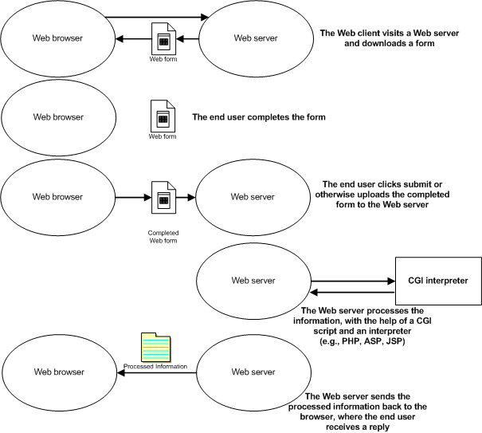
Diagramming a CGI Session

Slide 6
Parsing Data
A Web form receives submitted user input
CGI scripting (or an alternative) parses the data
The browser sends user-submitted information to the Web server as a raw text string
The basic element of a raw text string is a name=value pair
This raw text string consists of name=value pairs, delimited by ampersands (&)
After the server receives this information, a CGI script can parse and format the raw text string into a human-readable format, or enter the data into a database

Slide 7
Applied Example: FormMail
FormMail is popular because:
It is available free of charge from Matt's Script Archive (MSA)
It is written in Perl, which allows developers to use a free CGI interpreter
It is easy to customize
You install the script onto a Web server and refer to it in your forms

Slide 8
HTML5 and Forms
The main differences in form creation in HTML5 vs. HTML 4.01 are:
Cascading Style Sheets (CSS) are used for all form styles
Advanced features are now available, such as new <form> elements and attributes, and <input> types for better control of validation and input control
Many of the new elements and attributes are not supported by most browsers, even the ones that support HTML5

Slide 9
Basic Tags for Creating Web Forms
The <form> tag creates a user-input Web form
Attributes include:
method
"get": not as secure, sends unencrypted text
"post": encrypts, but can be easily broken
action
Specifies the name and location of the CGI script used to process the form
Place the <input>, <select> and <textarea> tags between <form> </form> tags to create form fields

Slide 10
Web Form Fields
User-input form fields include:
Text box
Radio button
Check box
Single-option select list
Multiple-option select list
Scrolling text area box
Password field
File upload button
Submit and Reset buttons

Slide 11
Forms and the name Attribute
All form field elements share an attribute: name
Identifies information you receive from a user and associates it with a value you specify
Helps organize user input

Slide 12
Text Boxes
Used to collect a single line of data from the user, such as name, e-mail or address information
Syntax: <input type="text" name="FieldName"/>
You can enter default text to appear in the form: <input type="text" name="FieldName" value="DefaultText"/>
In this example, "DefaultText" would appear in the user’s window

Slide 13
File Upload
Provides a Browse button and accompanying text box
Users click the Browse button and navigate to the file they want to upload
The path to the file chosen by the user will appear in the text box
Choose your file here: <input type="file" name="File"/>

Slide 14
Submit and Reset Buttons
Submit button
Sends completed user information from Web form to server
Reset button
Clears all information entered into form fields, instead of submitting information to server
Every form needs a means to submit data
<input type="submit"/>
<input type="reset"/>

Slide 15
Radio Buttons
A group of two or more mutually exclusive options
Never used as stand-alone items
Example:
Do you know carpentry?
<input type="radio" name="Carpentry" value="yes"/>
To present a preselected radio button, add the following attribute and value: checked="checked"

Slide 16
Check Boxes
A group of non-exclusive choices
Syntax:
<input type="checkbox" name="groupName"/>

Slide 17
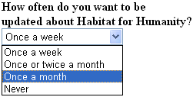
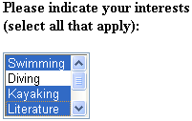
Select Lists
Drop-down lists of predetermined options
Created with the <select> tag
Two types:
Single-option select list Multiple-option select list
To allow the user to select multiple options, add the multiple attribute in the <select> tag

Slide 18
Scrolling Text Area Box
Created by the <textarea> element
Provides a scrolling text box into which a user can enter a few sentences, an address, a letter, etc.
Used to gather more than one line of text from the user
Attributes include:
cols
rows
wrap
Text between <textarea> tags will appear to users as default text within the box

Slide 19
Web Forms, CAPTCHA and SEO
Use CAPTCHA to reduce spam submissions sent to your forms
Consider search engine optimization (SEO) issues when developing Web forms

Slide 20
Lesson 6 Summary
Discuss the importance of CGI to Web forms
Discuss HTML5 and Web forms
Identify basic Web form tags
Construct a Web form using Web form fields

