Slide 1
Lesson 5: HTML Tables

Slide 2
Lesson 5 Objectives
Describe HTML table elements and attributes
Describe CSS properties for tables
Use table and data alignment options
Change the height and width of table elements
Specify column and row spanning
Compare HTML tables with CSS page structure

Slide 3
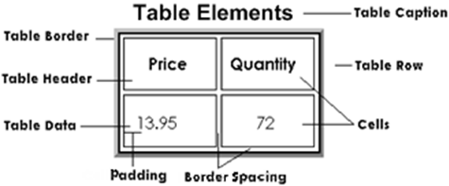
Introduction to HTML Tables
Present data that lends itself to tabular format
In HTML, do not use tables to structure entire pages

Slide 4
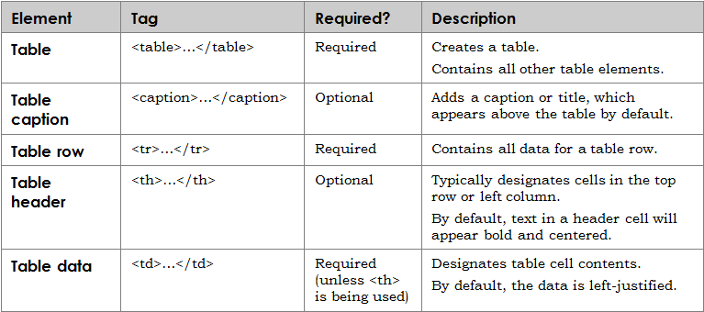
Table Element Tags

Slide 5
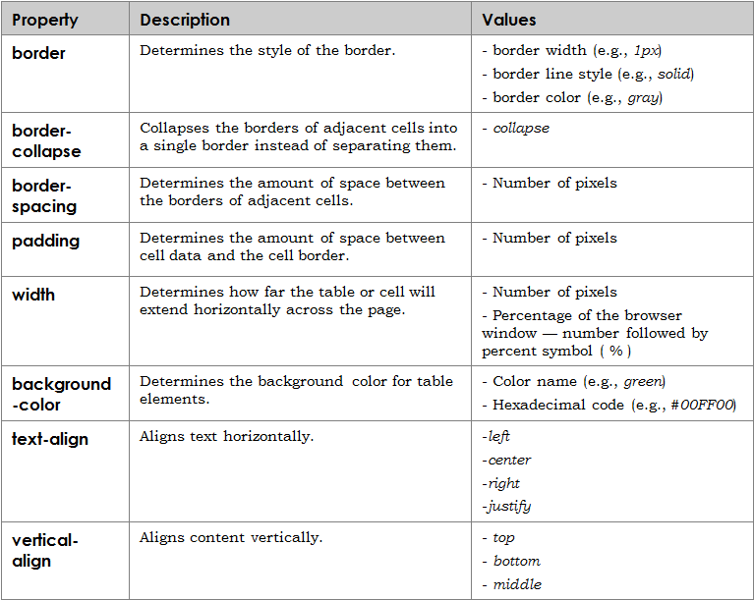
CSS Properties for All Table Elements

Slide 6
Table and Data Alignment Options
Defaults for table data:
Content in table header cells is aligned both horizontally and vertically to the center of the cell
Content in table data cells is aligned horizontally to the left and vertically to the center
You can change the alignment for an individual cell or for an entire row by using CSS properties:
text-align to specify horizontal alignment
vertical-align for vertical alignment

Slide 7
Height and Width of Table Elements
You can change the height or width of the table and individual cells by using the height property of the CSS table rule
You can specify:
Pixel values
Percentage values

Slide 8
Column and Row Spanning
You can specify that a column or row span two or more cells using the following attributes:
colspan to specify that a column span across multiple cells
rowspan to specify that a row span across multiple cells

Slide 9
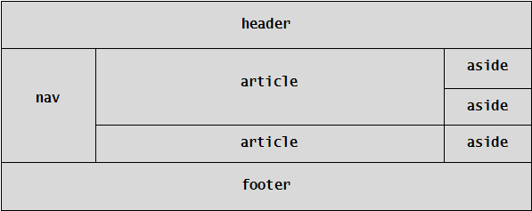
HTML Tables vs. CSS Page Structure
HTML tables were formerly used to create content structure for entire Web pages
The W3C recommends using HTML5 with CSS to structure a Web page
HTML5 structural elements of Web page:

Slide 10
Lesson 5 Summary
Describe HTML table elements and attributes
Describe CSS properties for tables
Use table and data alignment options
Change the height and width of table elements
Specify column and row spanning
Compare HTML tables with CSS page structure

