Slide 1
Lesson 4: Hyperlinks

Slide 2
Lesson 4 Objectives
Define and use the anchor element
Create local hyperlinks
Create external hyperlinks
Use images as hyperlinks
Create internal hyperlinks
Manage hyperlinks

Slide 3
The Anchor Element
The <a> element creates a hyperlink
The href attribute is used to specify the link's hypertext reference, or the target of the link
The syntax for using the anchor element to create a link is as follows:
<a href="URL"> linked text or image (or both) </a>

Slide 4
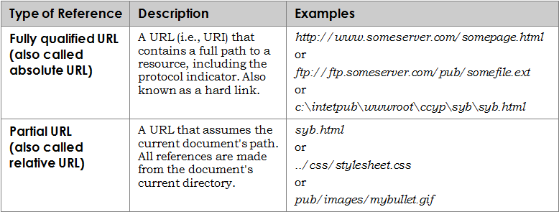
The Anchor Element (cont'd)
Examples of values for the URL when referencing external links:

Slide 5
The Anchor Element (cont'd)
Various protocols you can specify in a hyperlink URL:

Slide 6
The Anchor Element (cont'd)
Make sure that you:
Use a closing anchor tag </a>
Place quotation marks around the value
Include the closing bracket at the end of the opening <a> tag
Various issues to troubleshoot with hyperlinks include:
Text and images that disappear
Successive Web page text that appears as a hyperlink
Garbled code that appears on screen
Code that will not validate due to a problem <a> tag

Slide 7
Hyperlinks
Types of hyperlinks include:
Local hyperlink – a link you create from one file on your local system to another file on your local system
External hyperlink – a link you create from a file on your system to a separate file on the Internet
Internal link – a link you create to target other areas within the same page
You can create a hyperlink from an image by surrounding the image tag with opening and closing anchor tags

Slide 8
Creating Internal Links
Creating an internal link requires two steps:
Use the anchor element, <a>, with the id attribute to define an area as a target (the bookmark or anchor)
In another portion of the page, create the link that points to the bookmark using the anchor element with the hypertext reference (href) attribute

Slide 9
Managing Hyperlinks
All hyperlinks need to be verified
Verify that the URL or other reference is valid
Verify that the target page or location is accessible
Hyperlinks need to be managed
Over time, URLs (and content) change
"Dead" links frustrate users
Use automated link-checking software to validate hyperlinks
Manually check links to verify relevance of linked content

Slide 10
Lesson 4 Summary
Define and use the anchor element
Create local hyperlinks
Create external hyperlinks
Use images as hyperlinks
Create internal hyperlinks
Manage hyperlinks

