Slide 1
Phonology Part 1
Composition

Slide 2
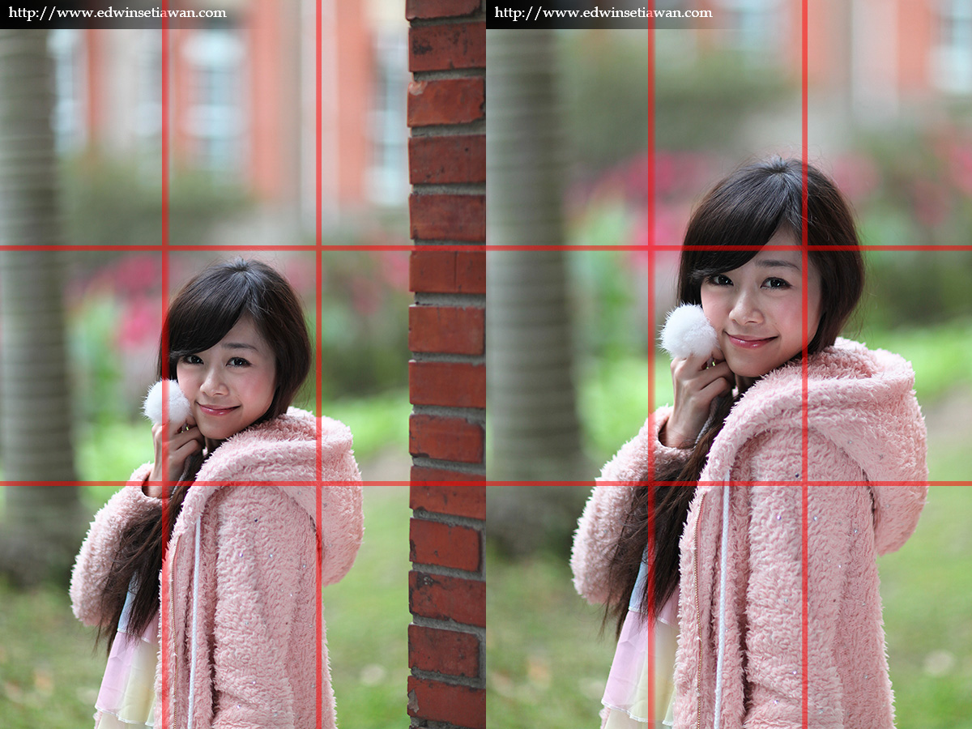
Composition
How photographers frame their subject

Slide 3
Terms to Know
Format
Magnification
Perspective
Background Control
Bull's Eye
Rule of Thirds
Rule of Odds
Symmetry
Negative Space
Repetition

Slide 4
Format: Horizontal, Vertical or Square
Vertical
Format
Horizontal
Square

Slide 5
Horizontal Format

Slide 6
Vertical Format

Slide 7
Square Format
You can crop an image into the square format when editing the photo.
Sometimes it’s best to shoot an image in both horizontal and vertical format. Your picture could be used on a calendar or a magazine cover.

Slide 8
Magnification
How much do you need to zoom in?
How much of the background do you want in your photo?
How large do you want your subject to appear in the photo?
Beginners:
Take multiple photos while zooming in or out. You can zoom by walking closer to the image or backing up. You can also use the zoom feature on the camera.

Slide 9
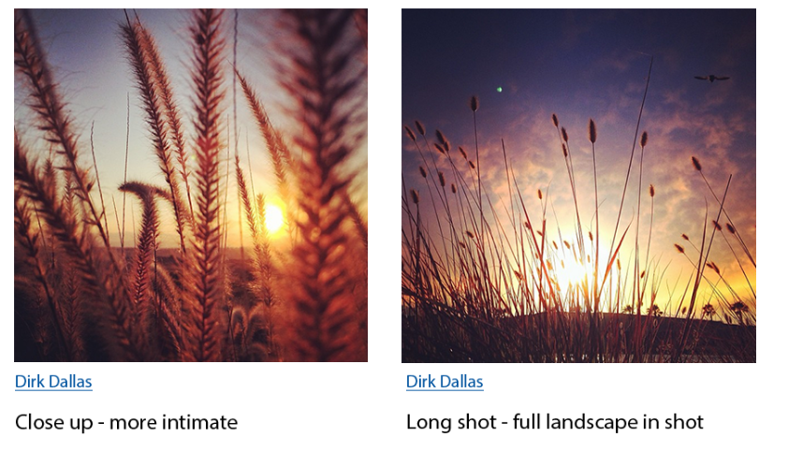

Slide 10
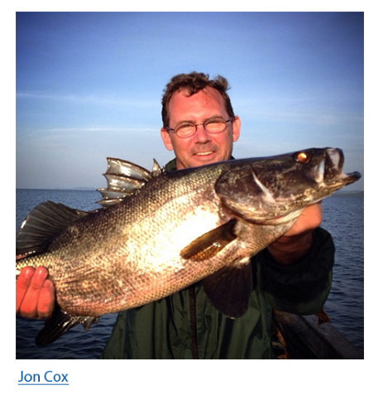
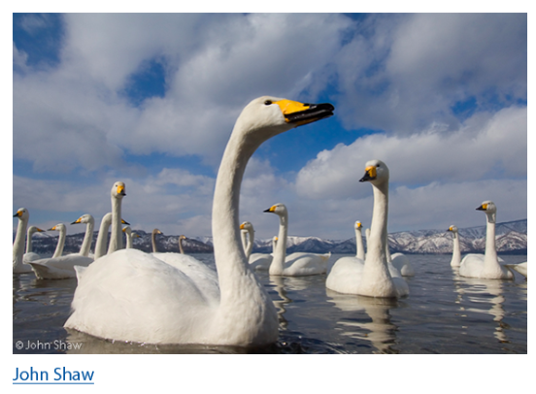
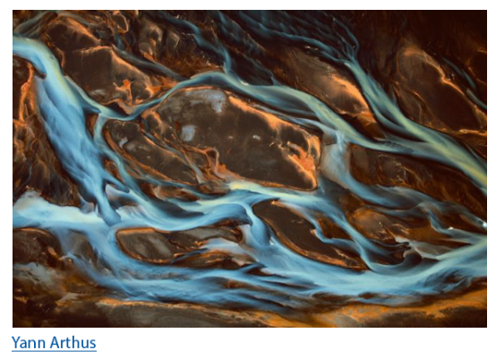
Perspective: High, Low, Head on
High Perspective
Head-On Perspective
Low Perspective
Fish is held out away from fisherman, camera is close to fish; therefore, the fish appears larger than it really is.
Swans photographed from below, making them look larger than normal.
Taken from Above the subject, looks very abstract

Slide 11
Change the perspective of your photos and it can make a huge different/impact on the quality of your images.

Slide 12
Quiz 1:
Using a perspective from above…
(A) creates a realistic representation of the image
(B) Abstracts the image
(C) Distorts the proportion of the image
(D) Allows the viewer to relate directly to the image

Slide 13
Perspective as Vanishing Points

Slide 14
No-Point Perspective

Slide 15
One-Point Perspective

Slide 16
Two-Point Perspective

Slide 17
Three-Point Perspective

Slide 18
Quiz 2:
This image is an example of a ____________?
(A) no-point perspective
(B) one-point perspective
(C) two-point perspective
(D) three-point perspective

Slide 19
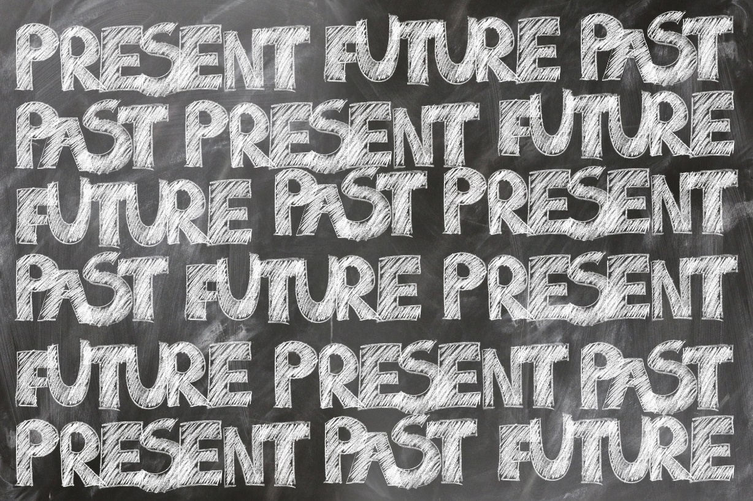
Quiz 3:
This image is an example of a ____________?
(A) no-point perspective
(B) one-point perspective
(C) two-point perspective
(D) three-point perspective

Slide 20
Background Control

Slide 21
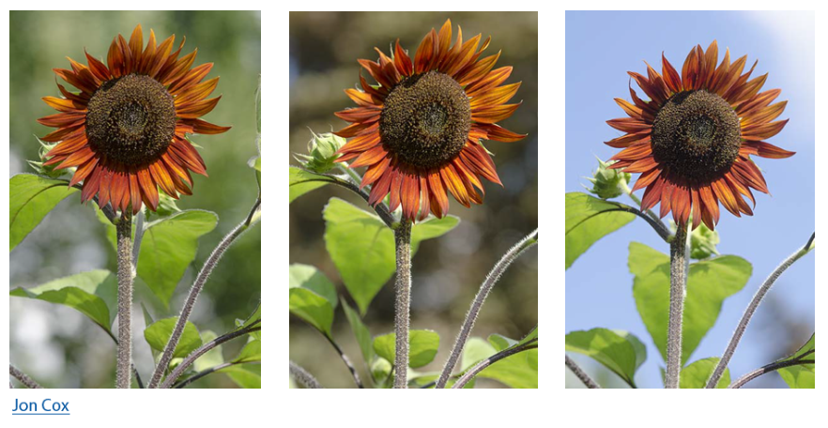
Background Control

Slide 22
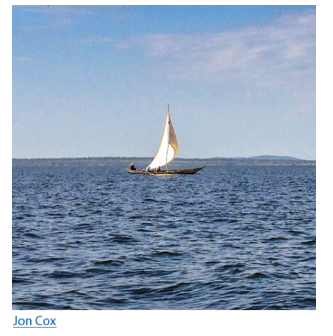
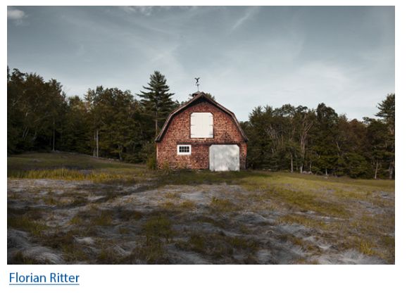
Bulls Eye

Slide 23
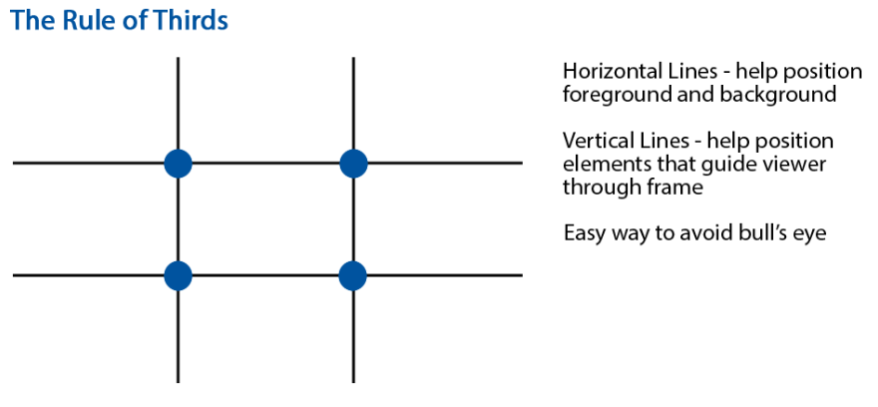
Rule of Thirds

Slide 24
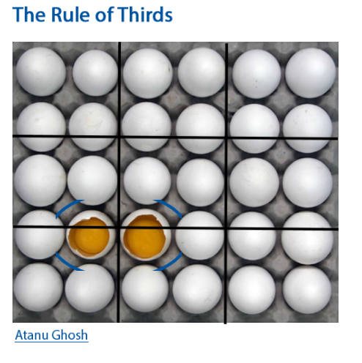
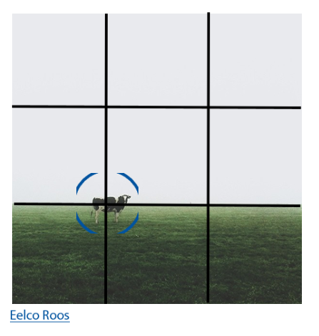
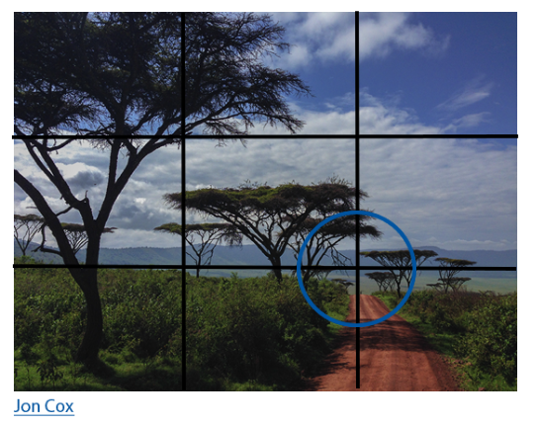
Rule of Thirds

Slide 25
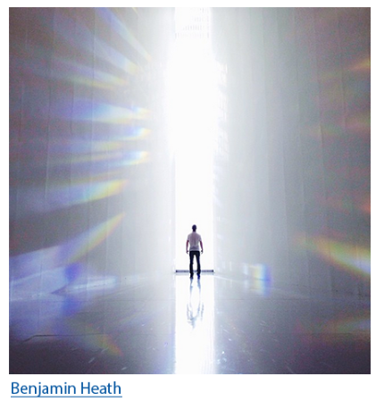
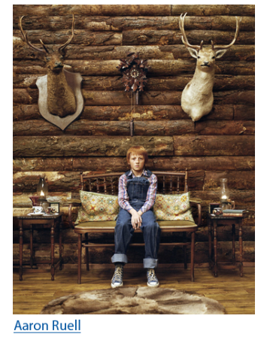
Rule of Odds
Generally, photos with an odd number of subjects look more appealing than an even number of subjects.

Slide 26
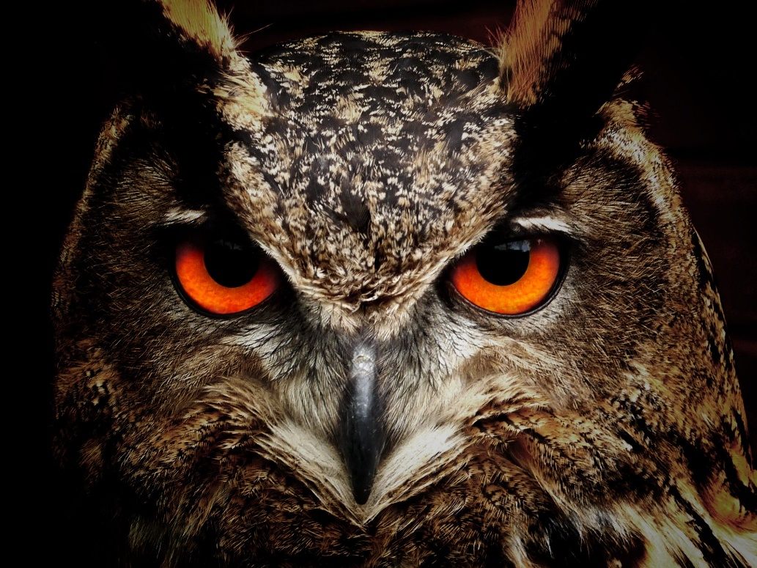
Quiz 4:
This image is an example of which technique?
(A) Rule of Thirds
(B) Rule of Odds
(C) Bulls Eye
(D) Both B & C

Slide 27
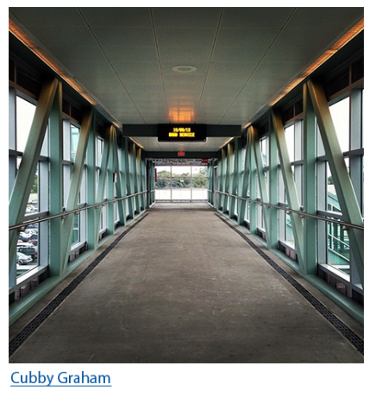
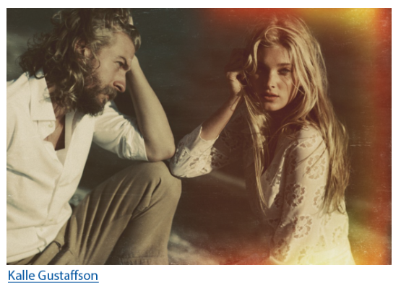
Symmetry

Slide 28
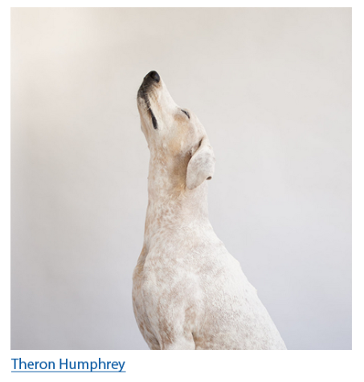
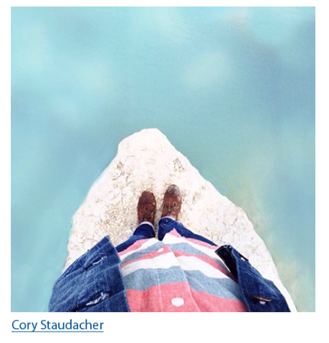
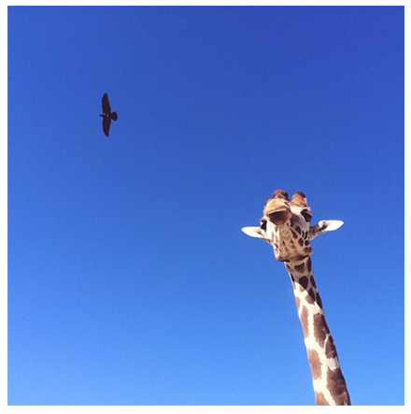
Negative Space

Slide 29
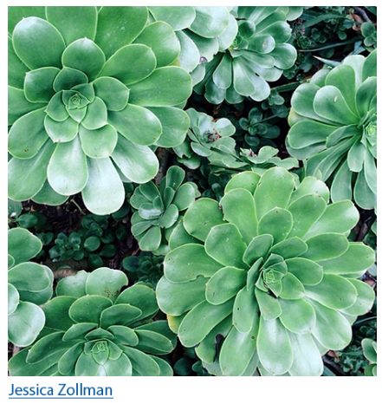
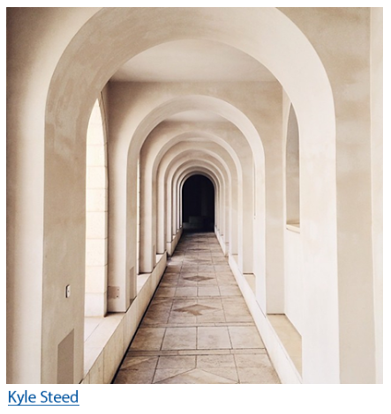
Repetition

Slide 30
Quiz 5:
This image is an example of which technique?
(A) Negative Space
(B) High Perspective
(C) Symmetry
(D) Both A & B

Slide 31
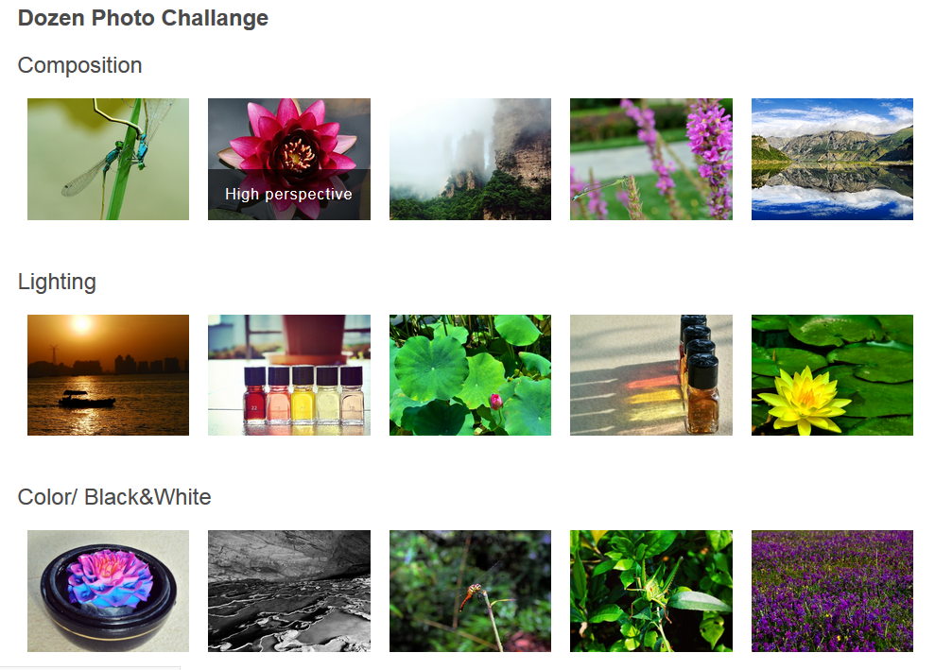
Assignment
Use your cellphones and take pictures
Keep in mind the composition techniques you have learned
Take pictures representing each technique (i.e. format, magnification, Perspective, Background Control, Bulls Eye, Rule of Thirds, Rule of Odds, Symmetry, Negative Space, Repetition) **Some photos you can combine techniques
You will upload four of your best shots to your Photography Pages
You will Add a Title “Composition”
You will label each photo with the technique(s) you used
Labeled
Use an App to Crop photos into the same size
SNAPSEED is an excellent App for both Android & iPhone

